Slide 1
Light Stages Face Caputure 관련 내용을 중심으로
2020. 02. 서준원
The Light Stages and Their Applications to Photoreal Digital Actors Paul Debevec

Slide 2
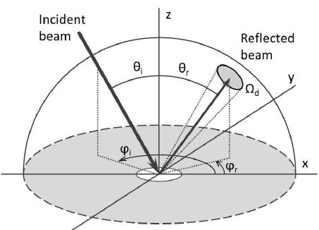
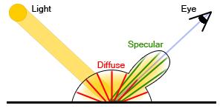
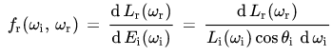
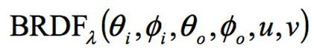
BRDF
Bidirectional Reflectance Distribution Function (양방향 반사율 분포 함수)
Diffuse BRDF
Specular BRDF
four-dimensional bi-directional reflectance distribution function

Slide 3
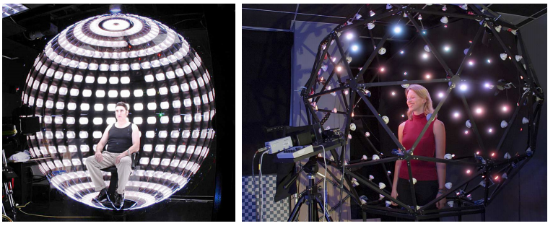
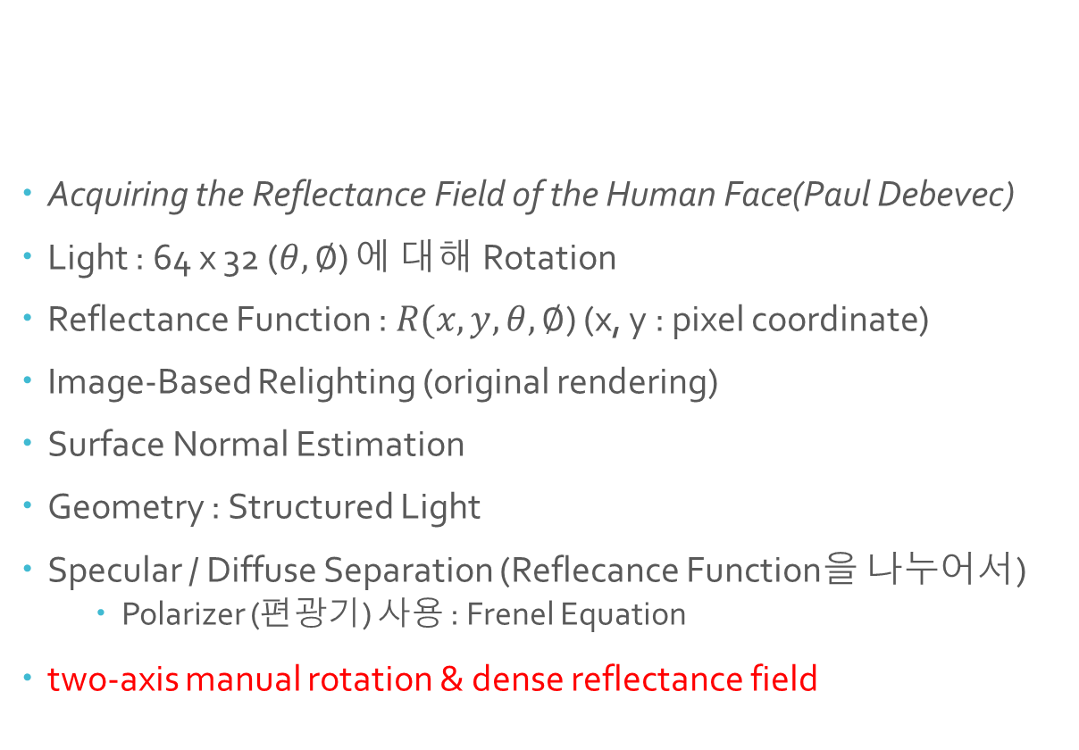
Light Stages 1
Acquiring the Reflectance Field of the Human Face(Paul Debevec)
Light : 64 x 32 ($θ,∅$) 에 대해 Rotation
Reflectance Function : $R(x, y, θ,∅$) (x, y : pixel coordinate)
Image-Based Relighting (original rendering)
Surface Normal Estimation
Geometry : Structured Light
Specular / Diffuse Separation (Reflecance Function을 나누어서)
Polarizer (편광기) 사용 : Frenel Equation
two-axis manual rotation & dense reflectance field

Slide 4
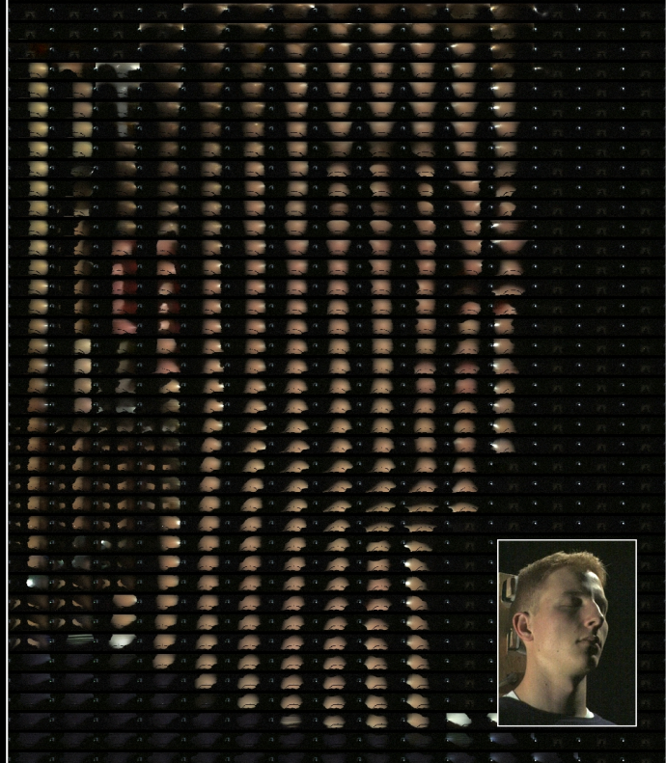
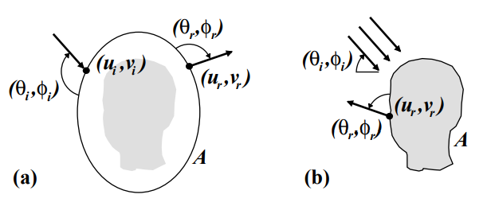
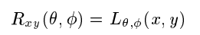
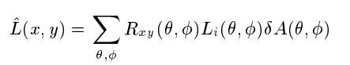
Acquiring the Reflectance Field of a Human Face (Paul Debevec)
Reflectance Field
Reflectance function for
a particular viewpoint
Reflectance Function for a pixel
Re-Illuminating (Relighting)

Slide 5
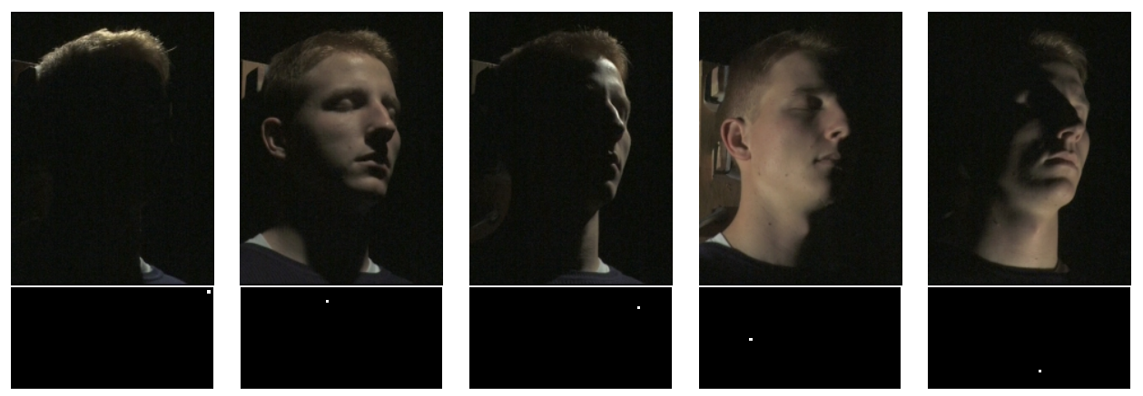
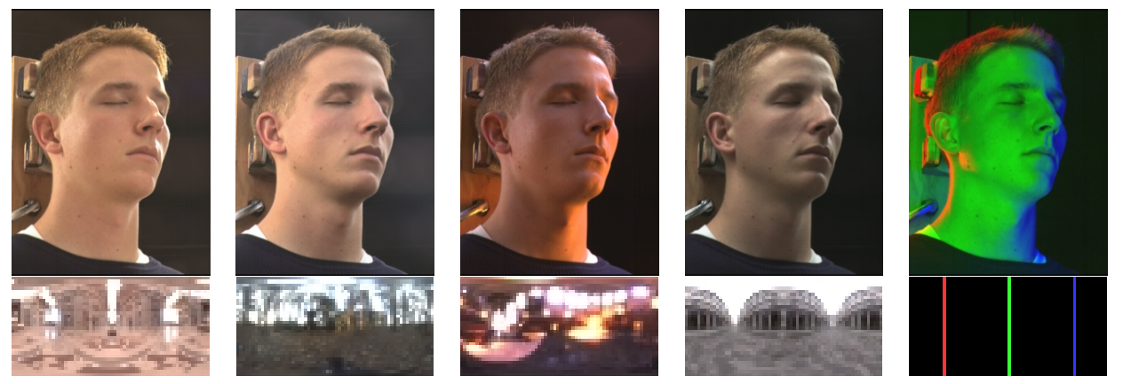
Acquiring the Reflectance Field of a Human Face (Paul Debevec)

Slide 6
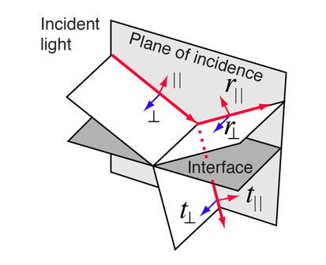
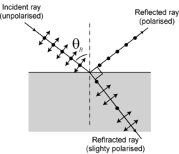
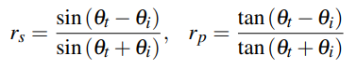
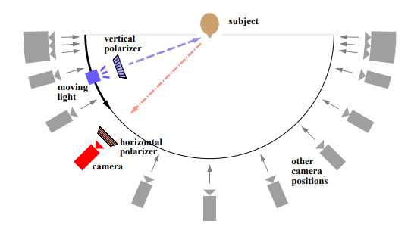
Polarization-Based Analysis of Reflected Light
Frenel Equation
Brewster's angle
Separation Using Linearity
Horizontal(Light) + Vertical(Camera) -> half of the diffusely reflected light (I1 = 0.5 * Diffuse)
Horizontal(Light) + Horizontal(Camera) -> (I2 = 0.5 * Diffuse + Specular )

Slide 7
Skin Reflectance
Diffuse & Specular
Separation using Polarization (Fresnel Equation)
Specular : Incident Ray’s Polarization 유지
Diffuse : Unpolarized
Diffuse reflectance function & Specular reflectance function
Surface Normal & Albedo (estimation : derived from the fitted diffuse reflectance lobe for each pixel)
Circular Polarization (Light source simultaneously)
Multiview 에서 사용
Near the Brewster angle the reflection is weak, making recovery of true specular reflectance unstable
다양한 Polarization Scheme
Fast Capture, Stable Specular Reflection on Spheres
Polarization-Based Analysis of Reflected Light

Slide 8
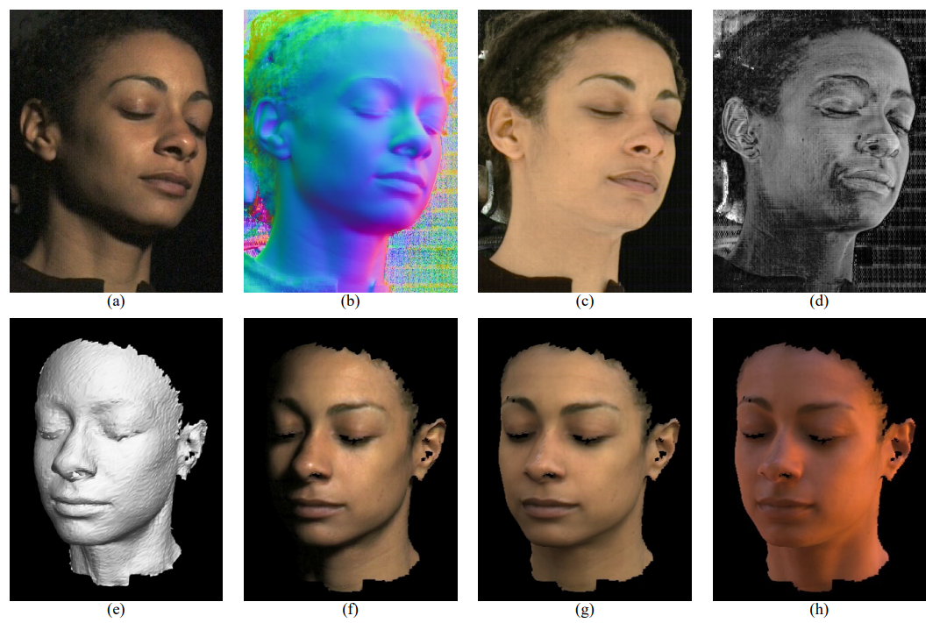
Viewpoint Change (Calibration is pre-computed)
Rendering
Face geometry recovered using structured lighting (With Geometry)
Acquiring the Reflectance Field of a Human Face (Paul Debevec)
Surface Normal
Albedo
Specular Energy
Face Geometry
Rendering under various lighting environments

Slide 9
Light Stages
Light Stage 2: Faster Capture and Facial Animation
Recording the reflectance of a face faster by including a set of thirty strobe-lights on a semicircular arm in eight seconds.
Light Stage 3: Lighting Reproduction
156 controllable RGB LED lamps mounted on a geodesic dome of 2m diameter
Light Stage 5: Performance Relighting
156 bright white LED lamps
record an actor’s reflectance dynamically using time-multiplexed illumination and high-speed video
facial geometry and reflectance capture in conjunction with polarized spherical gradient illumination
Light Stage 6: Re-lighting the Whole Body
Light Stage X (LS X)
330 LED light sources, each with many multi-spectral illuminants with fine grained control over spectra, intensity and polarization of incident light
Multiview Capture

Slide 10
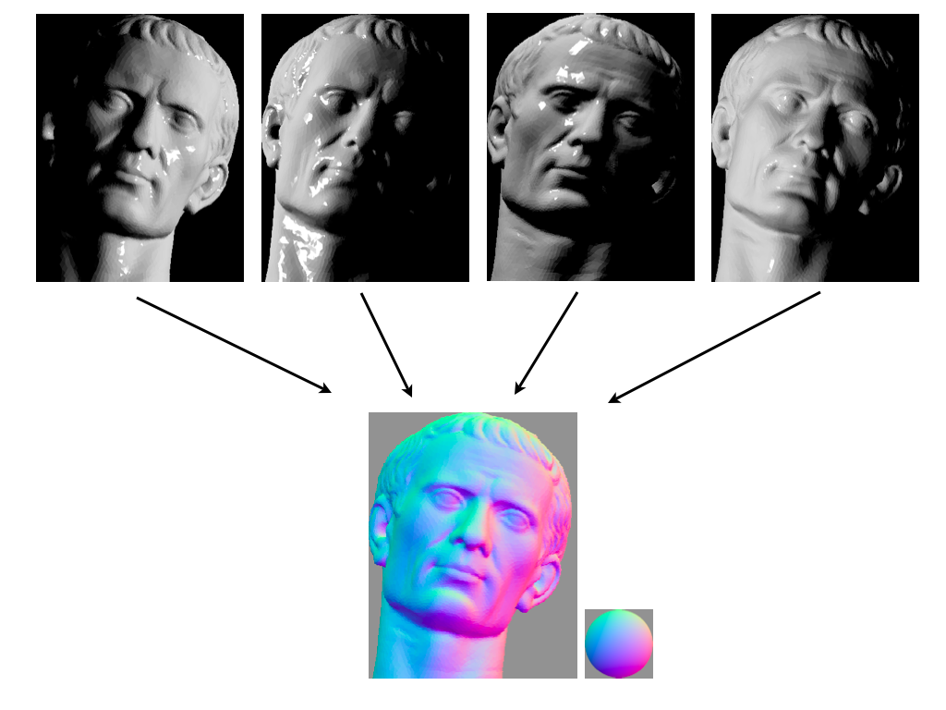
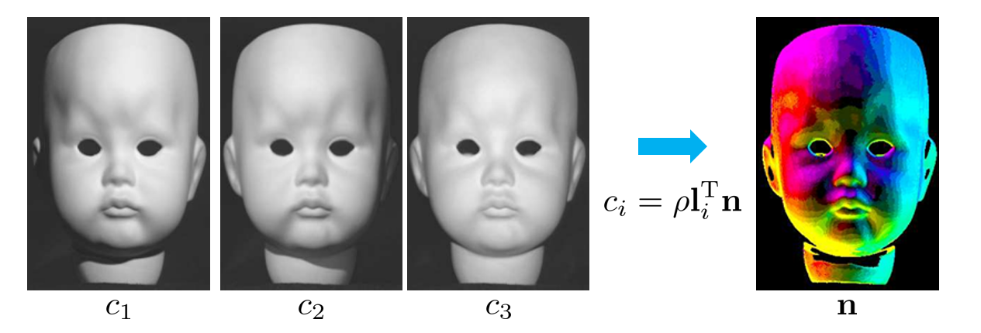
Photometric Stereo
Lambertian surface
multiple illumination directions
Surface Normal
&
Albedo
R. J. Woodham. Photometric method for determining surface orientation from multiple images

Slide 11
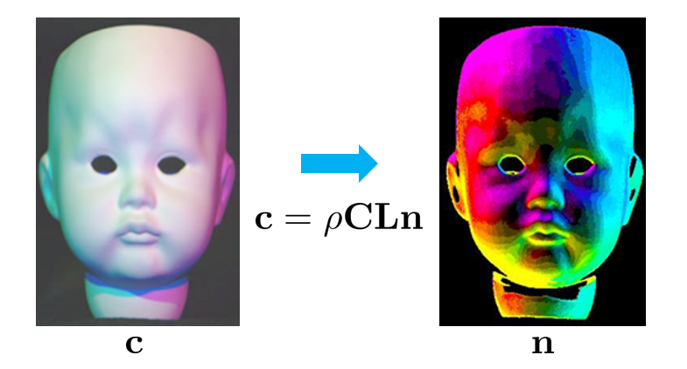
Single-Shot Reflectance Measurement
Taking many images of the object under a dense sampling of lighting directions
requiring either long capture times or specialized high-speed cameras
Three colored lights to perform photometric stereo in a single photograph, which is possible under the constant chromaticity assumption that all scene materials vary only in brightness, and not in hue or saturation
Single-Shot Reflectance Measurement from Polarized Color Gradient Illumination (Graham, Fyffe Paul Debevec)

Slide 12
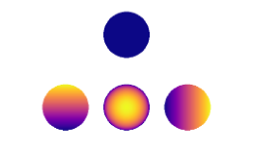
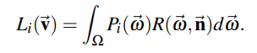
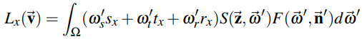
Spherical Harmonics
Rapid Acquisition of Specular and Diffuse Normal Maps from Polarized Spherical Gradient Illumination (Paul Debevec)
Digitize facial geometry with sub-millimeter precision :
leveraging the full sphere of LED light sources in Light Stage 5 to create spherical illumination patterns.
Instead of lighting the face one direction at a time, requiring hundreds of photographs to record reflectance functions, reflectance functions would be measured using computational illumination patterns based on the first four spherical harmonics [Ma et al. 2007].
Spherical Harmonics
The total energy of a pixel’s reflectance function : 0'th order spherical harmonic.
The first three 1st order spherical harmonics oriented along the three principal coordinate axes : surface normal, since a Lambertian reflectance lobe is symmetrically oriented along the normal.
Diffuse Normal
Specular Normal

Slide 13
Gradient Illumination Face Scanning
Rapid Acquisition of Specular and Diffuse Normal Maps from Polarized Spherical Gradient Illumination (Paul Debevec)
Polarized Spherical Gradient Illumination
Spherical Lightingseparate photometric albedo and normal maps for specular (surface) and diffuse (subsurface) reflection by employing polarization of incident lighting.
estimate surface normal maps of an object from either its diffuse or specular reflectance using four spherical gradient illumination patterns
the diffuse and specular normal maps of an object to be measured independently
Scattering material에 대해 Specular normal map이 효과적
limits the acquisition to a single viewpoint providing limited coverage of the scanned subject.

Slide 14
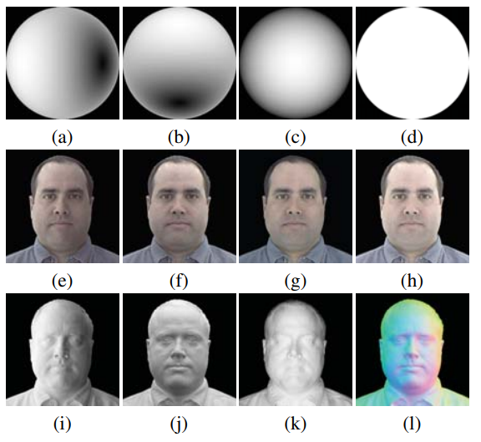
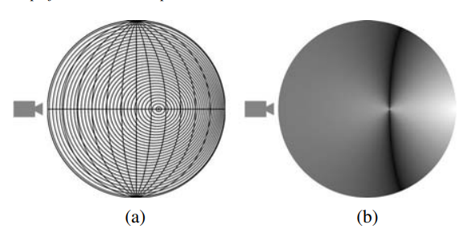
Computing normal from x, y, z
lighting using reflectance function Lambertian Surface Reflection & Specular Surface Reflection.
Gradient Illumination Face Scanning
Near the Brewster angle
the reflection is weak, making recovery of true specular reflectance unstable
Linear / Circular polarizers
Surface Geometry
: structured light scan +surface normal based on the specular reflectance

Slide 15
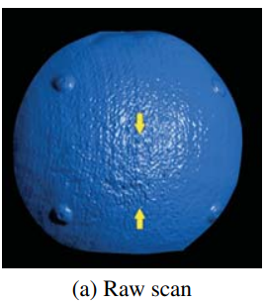
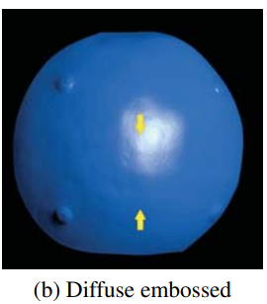
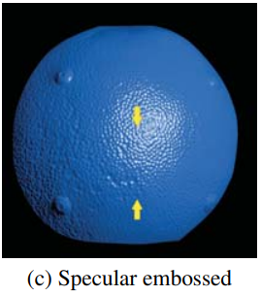
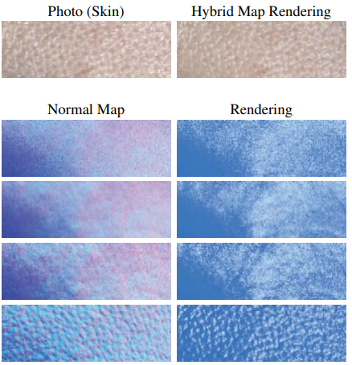
Gradient Illumination Face Scanning

Slide 16
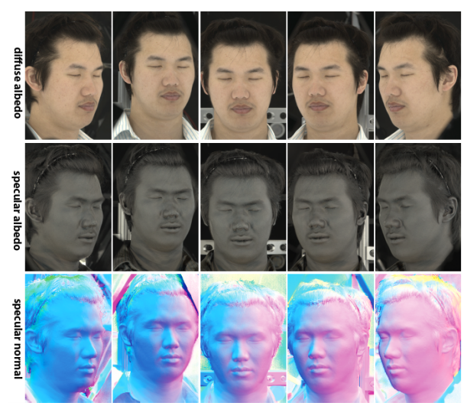
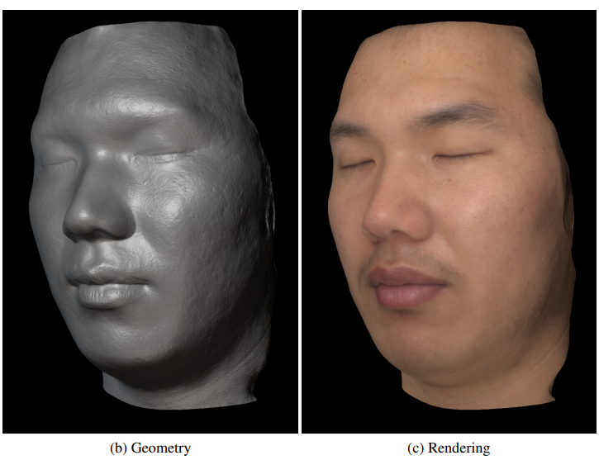
Multiview Capture and Light Stage X
Multiview Face Capture using Polarized Spherical Gradient Illumination (Abhijeet Ghosh, Paul Debevec)
Multiview Camera Setup
Stereo Reconstruction

Slide 17
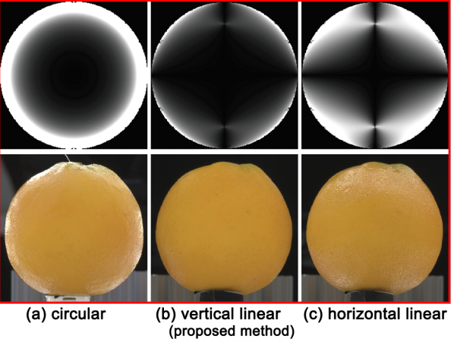
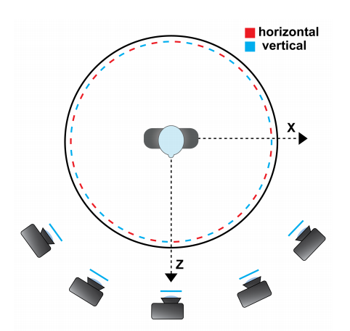
Multiview Capture and Light Stage X
Diffuse-Specular separation from just two photographs
Ghosh et al.’s technique requires four photographs
Latitude-Longitude Linear Polarization
Cameras’ Polarizers : Static Vertical Polarizer
specular cancellation

Slide 18
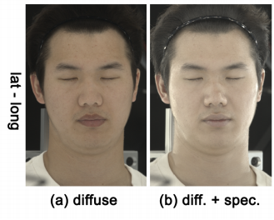
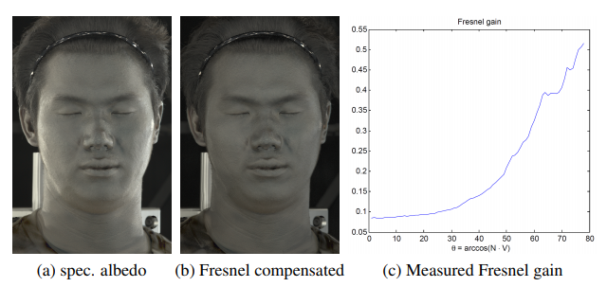
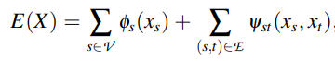
Multiview Capture and Light Stage X
diffuse and specular albedo
& normal maps
from multiple viewpoints
compensate for the Fresnel gain
(to make the specular albedo maps less view-dependent and more suitable for stereo.)
Stereo Reconstruction
(Cost function minimization (no merging))
Geometry 얻는 과정이 까다로움

Slide 19
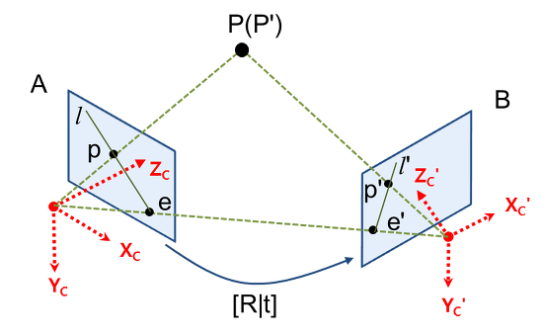
Multi View Stereo (MVS)
Geometry : Consistency를 바탕으로 (여러 이미지에서의 points correspondence) depth를 계산 (Camera Calibration 이용)
SL 방식에 비해 정확도가 떨어지고, 어렵다.
Correspondence를 파악하기 어려움
Surface normal data를 사용해서 minimum cost function 방법으로 접근하기도 함.
Light Stage에서 rendering을 해내기 위해서는 Base Geometry 정보가 필요하다 (거기에다가 surface normal을 만들어내고, albedo 정보를 만들어내는 것이기 때문)

Slide 20
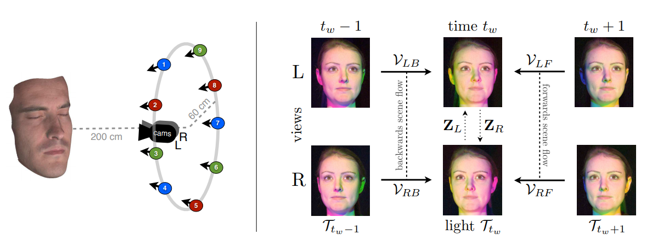
Photometric Sceneflow
Photometric Stereo + Multiview Stereo + Optical Flow
Optical flow : Dynamically changing object
high-quality dynamic 3D reconstruction
Photogeometric Scene Flow for High-Detail Dynamic 3D Reconstruction

Slide 21
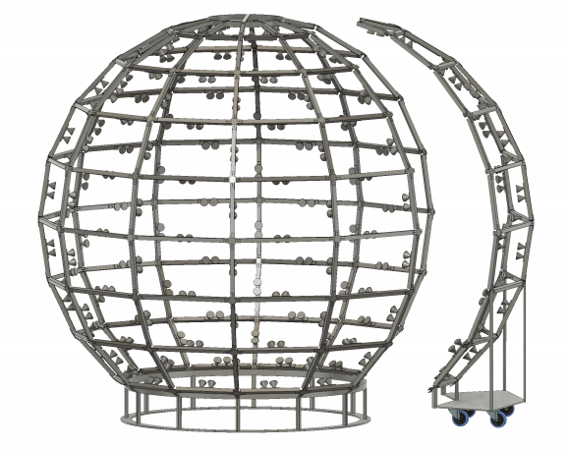
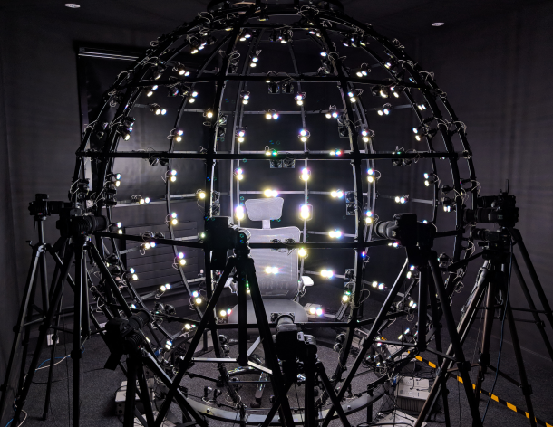
Conclusion
설계 모델
Light 개수, Polarization 방법
Multi-view vs Single-view (required scanning from three different angles to produce an ear-to-ear facial scan)
Structured Light 보다 좋은 점
기존의 surface normal, albedo estimation method?
High Setup cost
Base Geometry
SL?
구체적인 Surface Normal, Albedo estimation method

